Slide 1

OS Lab 3- Shell Scripting
Instructor
Saba Naseem
Saba.naseem@nu.edu.pk

Slide 2
What is “Shell”?
The “Shell” is simply another program which provides a basic human-OS interface.
It is a command interpreter
Built on top of the kernel
Enables users to run services provided by the UNIX/Linux OS
In its simplest form, a series of commands in a file is a shell program that saves having to retype commands to perform common tasks.
How to know what shell you use
echo $SHELL
What shells the OS is supporting? Type:
Cat /etc/shells

Slide 3
What is “Shell”?
Shell is an environment in which we can run our commands, programs, and shell scripts
There are different flavors of a shell, just as there are different flavors of operating systems
Each flavor of shell has its own set of recognized commands and functions
Current location of the running shell/bash? Type:
Which bash -> e.g, /bin/bash

Slide 4
Linux Shells
sh Bourne Shell (Original Shell)
bash Bourne Again Shell (GNU Improved Bourne Shell)
csh C-Shell (C-like Syntax)(Bill Joy of Univ. of California)
ksh Korn-Shell (Bourne+some C-shell)(David Korn of AT&T)
tcsh Turbo C-Shell (More User Friendly C-Shell).
To check shell:
$ echo $SHELL (shell is a pre-defined variable)
To switch shell:
You can switch from one shell to another by just typing the name of the shell.
exit return you back to previous shell
$ exec shellname (e.g., $ exec bash or simply type $bash)

Slide 5
Pipes
Connect processes using pipe „|‟ operator
Processes connected by pipes can run simultaneously and are automatically scheduled as data flows between them
Using „sort‟ command to sort output from “ls‟ command
# ls | sort

Slide 6
What is shell script?
A shell script is a script written for the shell
The basic concept of a shell script is a list of commands, which are listed in the order of execution
A good shell script will have comments, preceded by # sign, describing the steps.
All the scripts would have the .sh extension

Slide 7
What is shell script?
Before you add anything else to your script, you need to alert the system that a shell script is being started
This is done using the shebang construct.
For example −
#!/bin/bash
This tells the system that the commands that follow are to be executed by the Bourne shell
It's called a shebang because the # symbol is called a hash, and the ! symbol is called a bang

Slide 8
How to write shell scripts?
Use any editor (kwrite, kate etc) to write shell script
Set the execute permission for your script
through graphical interface
chmod +x script-name
chmod 755 script-name
Execute your script as:
./script-name

Slide 9
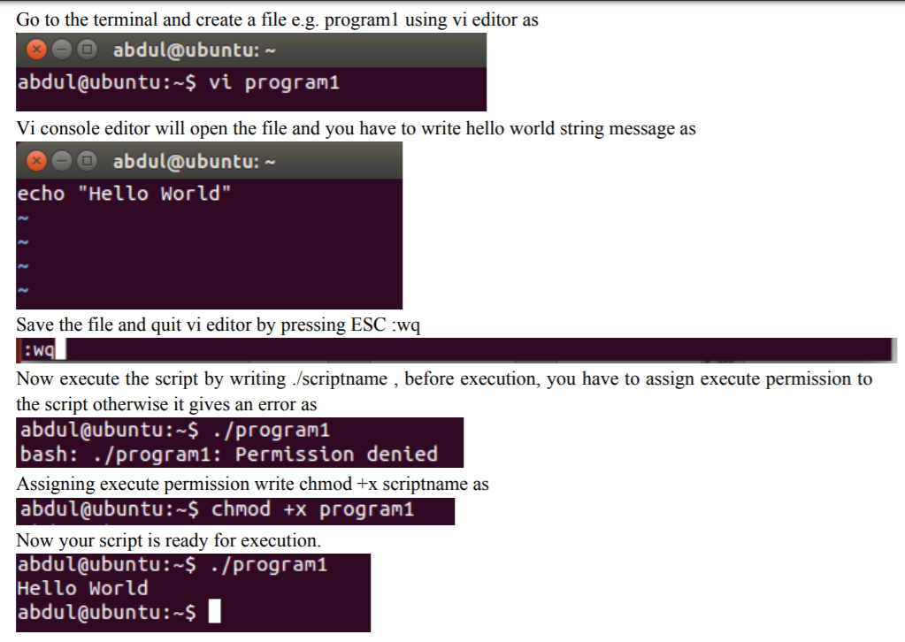

Slide 10
Commenting
Lines starting with # are comments except the very first line where #! indicates the location of the shell that will be run to execute the script.
On any line characters following an unquoted # are considered to be comments and ignored.
Comments are used to;
Identify who wrote it and when
Identify input variables
Make code easy to read
Explain complex code sections
Version control tracking
Record modifications

Slide 11
Variables in Shell
In Linux shell there are three types of variables
System or Environment variables
User defined variables
Parametric variables

Slide 12
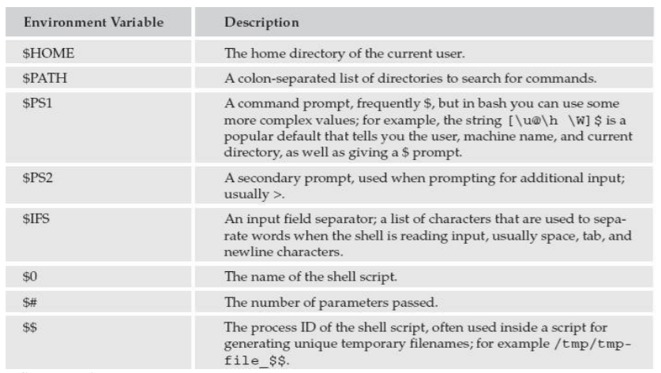

Slide 13
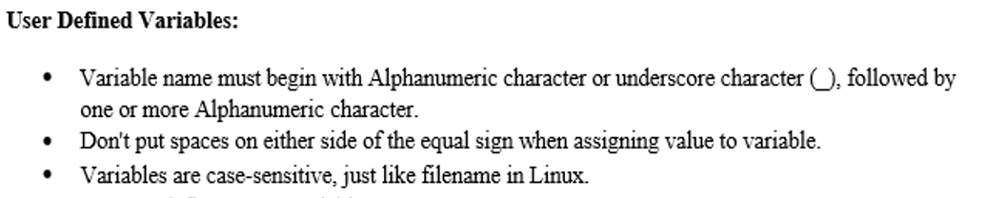
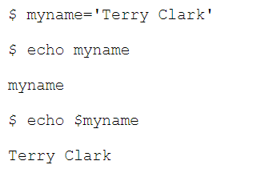

Slide 14
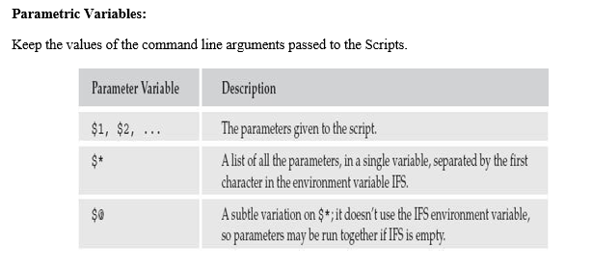
Notes:
Subtle : making use of clever and indirect methods to achieve something.

Slide 15
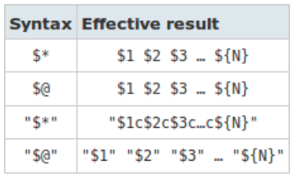

Slide 16
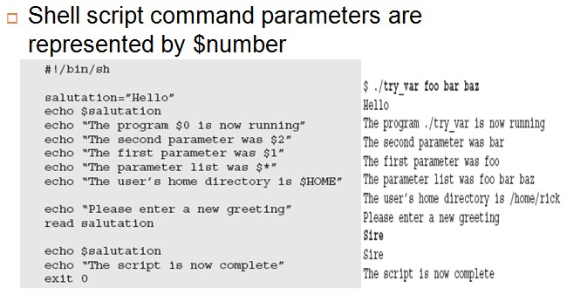
Notes:
The Internal Field Separator (IFS) that is used for word splitting after expansion and to split lines into words with the read builtin command.

Slide 17
A Shell Script Example
#!/bin/bash
# use ‘#” to add comments in shell script
#Author: Sumaira Mustafa
#shell scripting practice problem
#script follows here:
pwd
Ls

Slide 18
Shell Scripting
Tell Linux that the script file is executable
$ chmod u+x test.sh
$ chmod +x test.sh
Execute the shell-script
$ ./test.sh

Slide 19
My First Shell Script
$ vi myfirstscript.sh
#! /bin/sh
# The first example of a shell script
directory=`pwd`
echo Hello World!
echo The date today is `date`
echo The current directory is $directory
$ chmod +x myfirstscript.sh
$ ./myfirstscript.sh
Hello World!
The date today is Mon Mar 8 15:20:09 EST 2010
The current directory is /netscr/shubin/test

Slide 20
User Input
As shown on the hello script input from the standard input location is done via the read command.
Example
echo "Please enter three filenames:”
read filea fileb filec
echo “These files are used:$filea $fileb $filec”
Each read statement reads an entire line. In the above example if there are less than 3 items in the response the trailing(losing) variables will be set to blank ‘ ‘.
Three items are separated by one space.

Slide 21
Hello script
The following script asks the user to enter his name and displays a personalised hello.
#!/bin/sh
echo “Who am I talking to?”
read user_name
echo “Hello $user_name”
Try replacing “ with ‘ in the last line to see what happens.

Slide 22
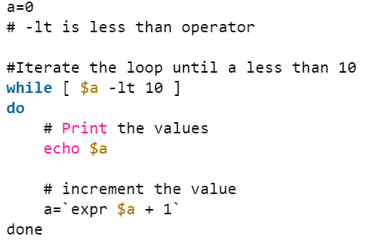
While Loop
while [ <some test> ] do <commands> done
Example:
#!/bin/bash
# Basic while loop
counter=1
while [ $counter -le 10 ]
do
echo $counter
((counter++))
done
echo All done

Slide 23
Until Loop
until [ <some test> ] do <commands> done
Example:
#!/bin/bash
# Basic until loop
counter=1
until [ $counter -gt 10 ]
do
echo $counter
((counter++))
done
echo All done

Slide 24
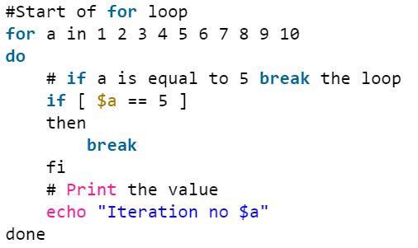
For Loop
for var in <list> do <commands> done
Example:
#!/bin/bash
# Basic for loop
names='Stan Kyle Cartman'
for name in $names
do
echo $name
done
echo All done

Slide 25
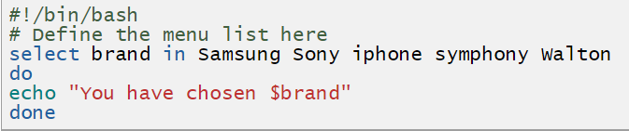
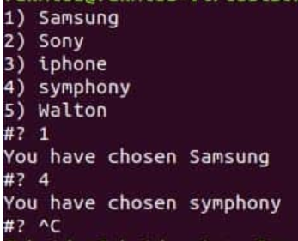
The select mechanism allows you to create a simple menu system. It has the following format:
select var in <list> do <commands> done
Example:
#!/bin/bash
# A simple menu system
names='Kyle Cartman Stan Quit'
select name in $names
do
if [ $name == 'Quit' ]
then
break
fi
echo Hello $name
done
echo Bye

Slide 26
Break & Continue statements
The break statement tells Bash to leave the loop straight away
Exit the currently running loop
The continue statement tells Bash to stop running through this iteration of the loop and begin the next iteration

